Slide 1
Vidyalankar Polytechnic
Program: Information Technology

Slide 2
Group No:- IF
Shourish Kothawale – 19202A0047
Shubham Jadhav– 19202A0011
Shishir Nath – 19202A0054
Piyush Nirbhavane– 19202A0006
Under the guidance of:
Er. Shridevi Taradi
AY 2021-2022

Slide 3
Project Domain :
Project Title :
Data Scraper for Google Maps
Category :
Industry

Slide 4
Abstract
Information is paramount nowadays and is seemingly growing day by day.
If correct information is delivered quickly, it can be a highly effective in situations.
To provide a solution to this problem we will create a data/web scraper for Google Maps for providing different kinds of data like name, phone, website etc.
Web Scrapers allow to find specific data on the internet and then export them into spreadsheets like Microsoft Excel sheet or a CSV file.
These web scrapers are built in many different programming languages, but python seems to be the most popular of them all as it has many different libraries that are perfect for the job.
They can be used in business analytics as it can help analyze competition, market research.

Slide 5
Introduction
Data Scraping is also known as web scraping.
It can help get data easily, and also help to channel data to other websites.
Google Maps is a website full of information. It contains the location of a place and even pinpoints it, and it has many different attributes for places like contact numbers, websites, contact number, rating, review count, timings etc.
The main aim of the application is to extract the data as quickly and efficiently as possible.
The application will have an array of functionalities, from searching for the place using an URL , keyword and even a special tab for restaurants which is the unique feature of the project.
Users will have an option to either keep the data with a blank phone number field or to remove the data.
After searching all the data this data has to be saved. To do this we will eb allowing the user to import the data into two formats Excel and CSV

Slide 6
Problem Statement
In today’s world information plays a very important part. Practically, everything we do requires information. With the world advancing information is growing and expanding at an extraordinary pace. With this comes the problem of unstructured data everywhere, along with redundant data. Every second new data is being created, for example with Google over 40,000 search queries are made every second, that’s a whopping 1.2 trillion searches per year. Around 44 zettabytes With so much data it is becoming more and more difficult to find data that is appropriate to the cause and in turn is making it difficult to find it. This can cause a major crisis for many people as the world works on data, from businesses to science data is integral. To perform appropriate searches data scrapers can be used. Data scrapers help to find only the appropriate data in a website so that you don’t have to search for the data on your own manually.
After looking through various data scraper one common thing was, they were subscription based, and they only had one option to search by that was using keywords. But with our Google Maps Web Scraper we will be provided to search for places using location, URL, Keyword and even a special search option for restaurants since they have different attributes compared to other types of location with generic characteristics.
Google maps contains a lot of data about a place from location to opening times, popular hours etc. These types of data can be used by businesses to analyze and formulate the correct strategy. Not only businesses but many other people who like to travel can search for data on famous places to plan out their next trip. Data Scrappers are not limited to a specific group of people, they can be used by everyone to find information about their liking.

Slide 7
Features / Functionalities of the project:
Extract data into Excel and CSV files
Filter Operations
Search Place using URL
Search Place using Keyword
Search Place using Location
Special Tab for Restaurants

Slide 8
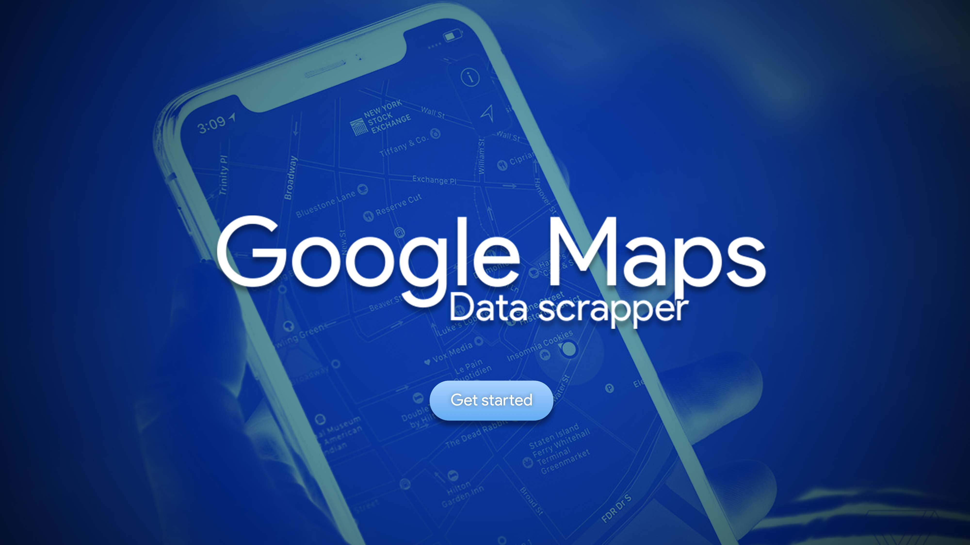
Design (Tentative):

Slide 9
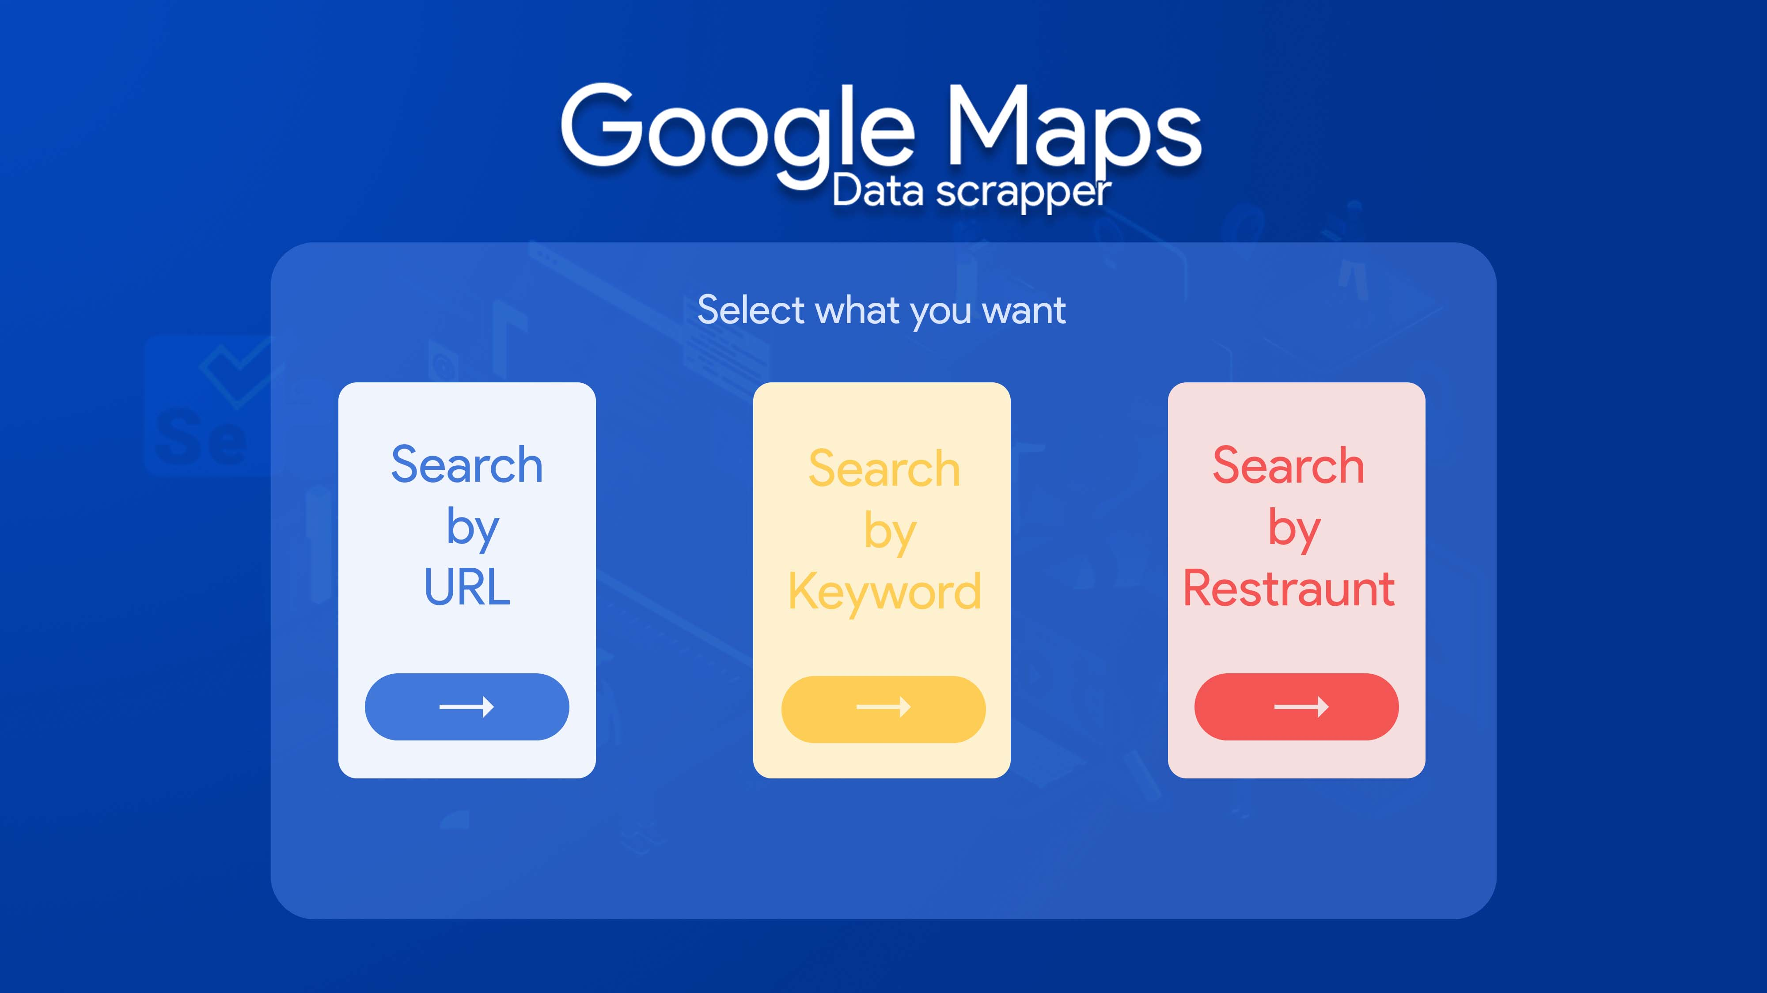
Design (Tentative):

Slide 10
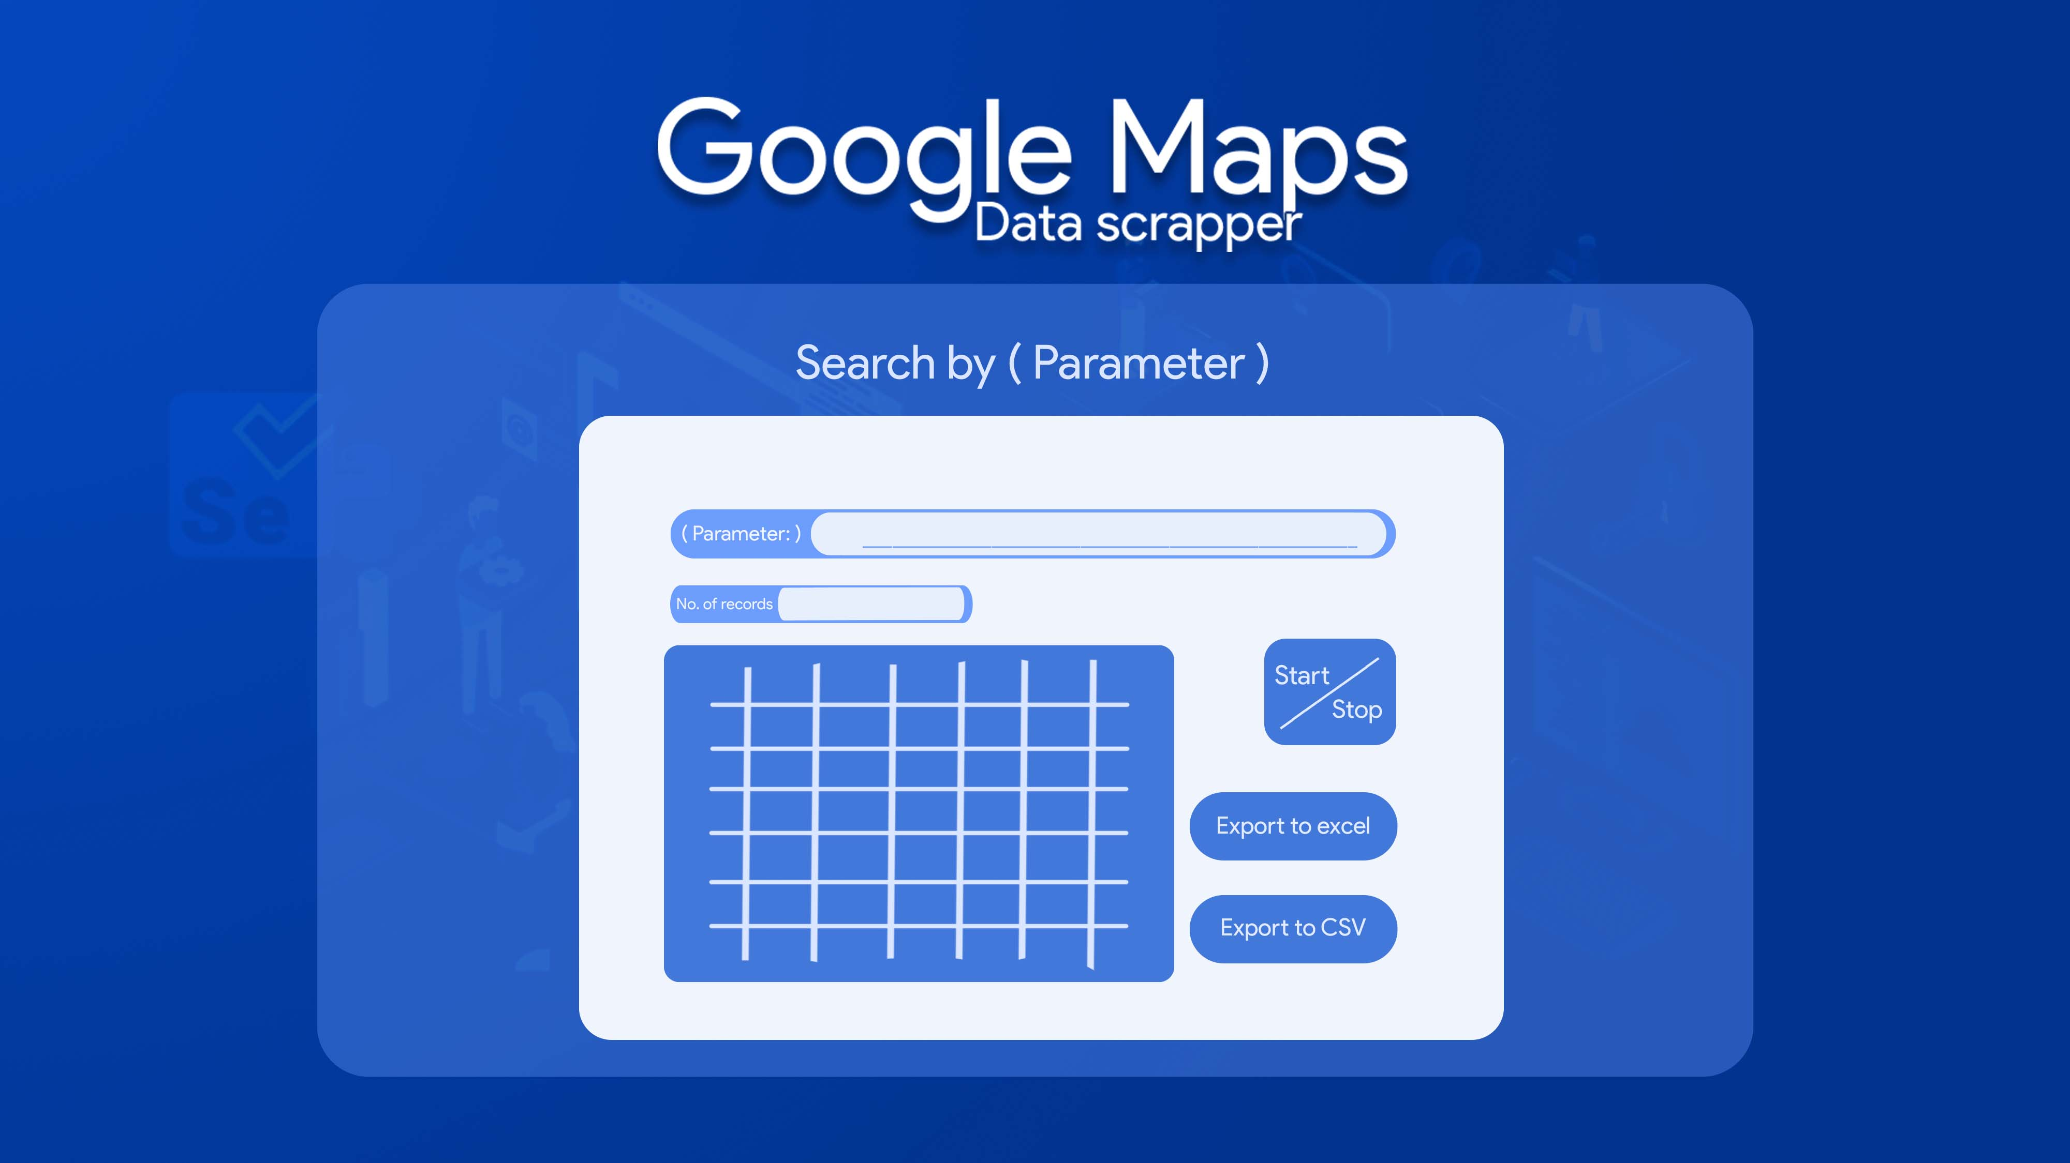
Design (Tentative):

Slide 11
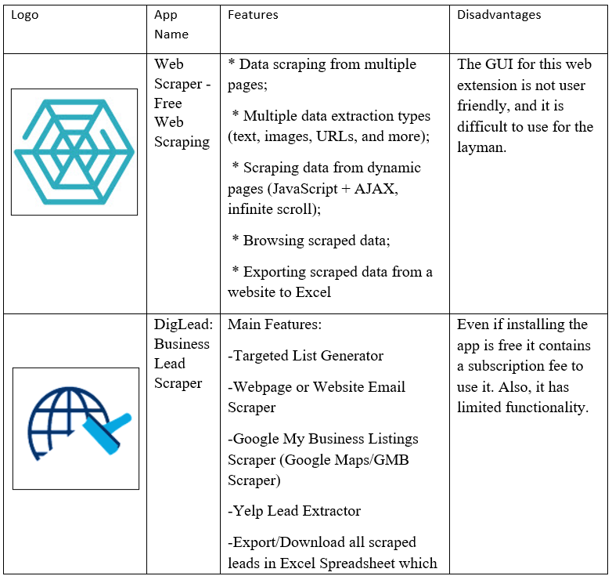
Literature Review / Market Survey

Slide 12
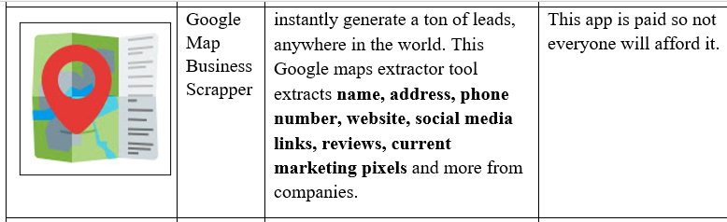
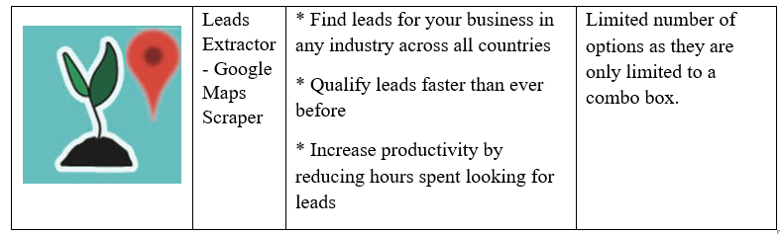
Literature Review / Market Survey

Slide 13
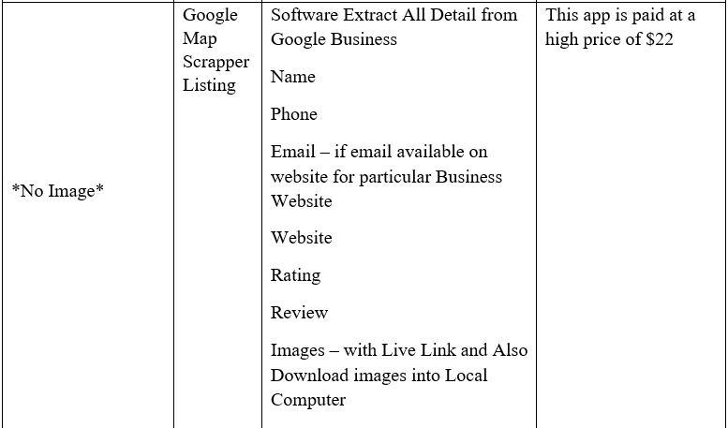
Literature Review / Market Survey

Slide 14
Modules / Users / Stakeholders
Users:
Naive User: The naive users are those users which interact with the application without having any knowledge about how it works. They just interact with the system to do their daily activities. This user will be the one that uses the Data Scraper for data extraction. The user will be performing the search queries through various ways. From entering keywords, URLs, Locations. The users also will be the ones to import the data into Excel or CSV.

Slide 15
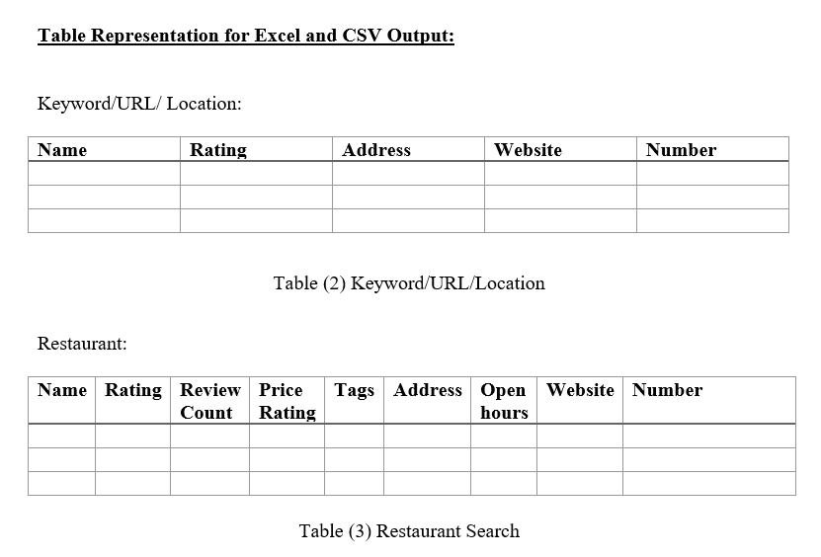
ER Diagram / Circuit Diagram

Slide 16
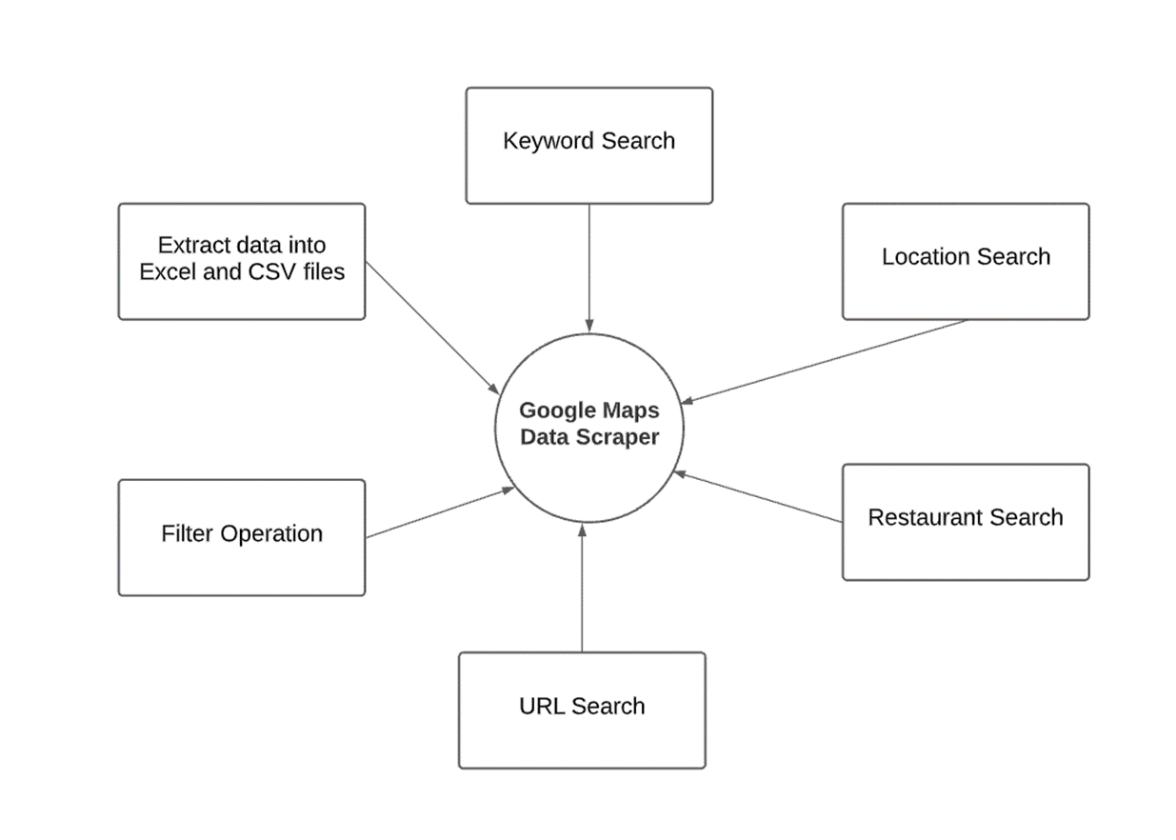
DFD Level 0

Slide 17
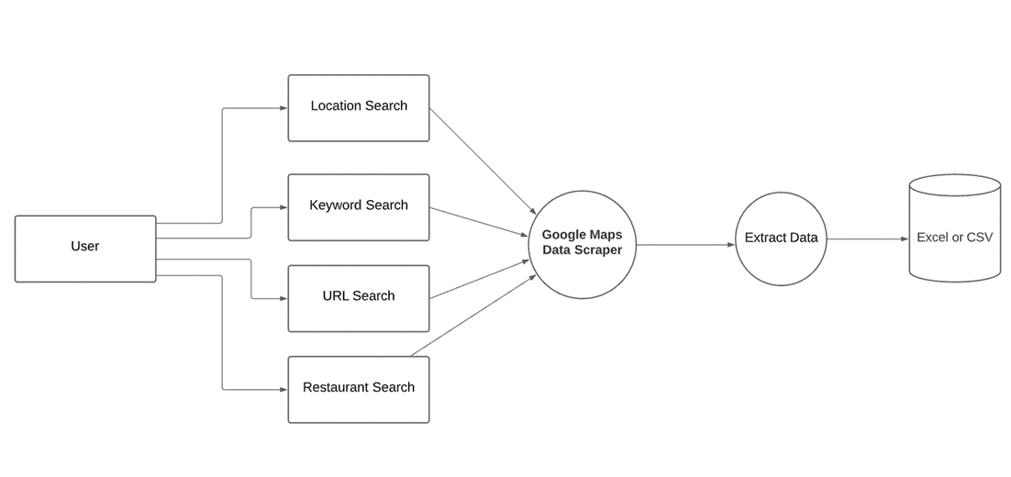
DFD Level 1

Slide 18
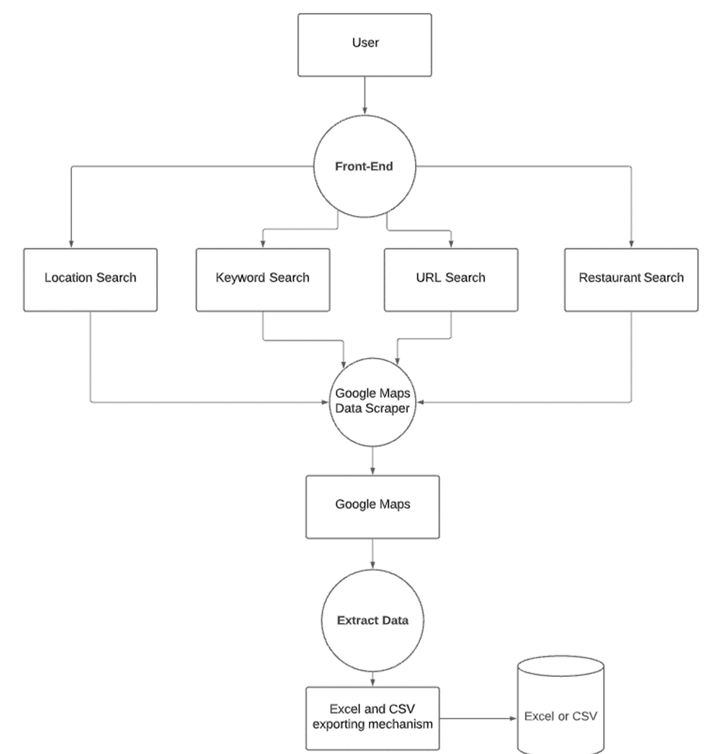
DFD Level 2

Slide 19
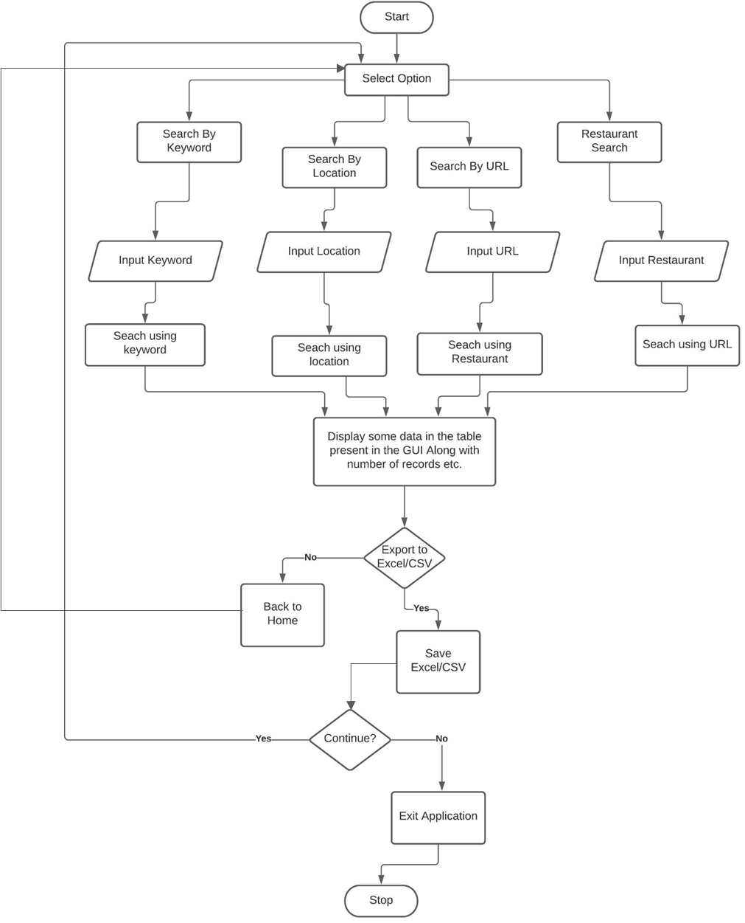
UML Diagram 1 : Flow Chart

Slide 20
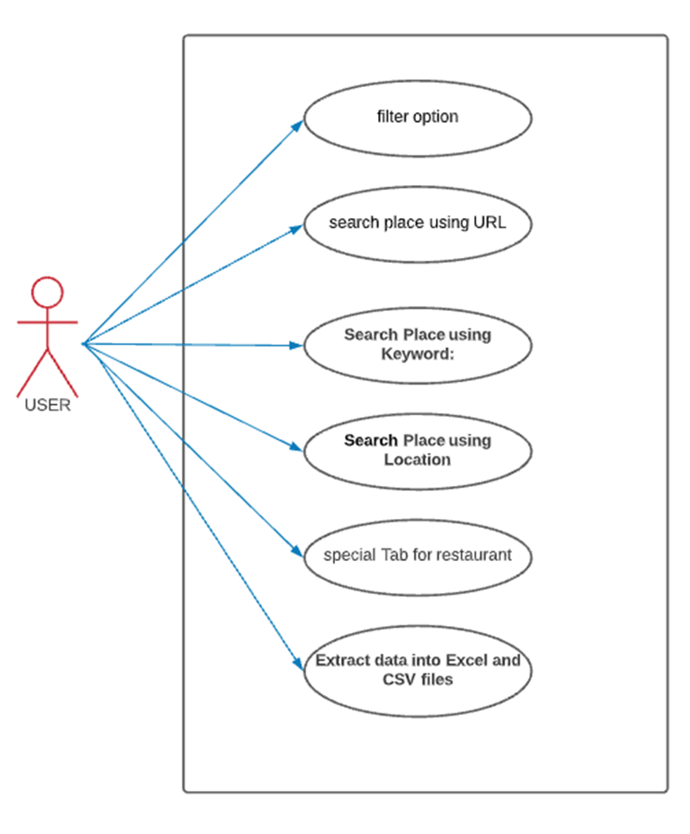
UML Diagram 2 : Use Case Diagram

Slide 21
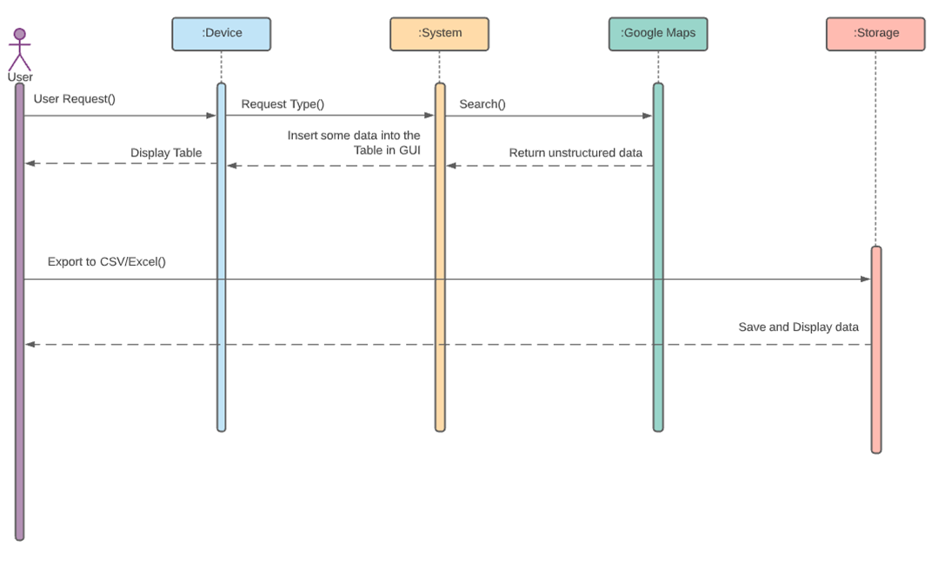
UML Diagram 3 : Sequence Diagram

Slide 22
Technologies Used
Hardware Requirement :-
The only hardware requirement for this project would be a laptop with minimum requirements of a 3.3GHz or faster 64-bit dual-core processor. The RAM required for this would be a minimum of 4GB but 8GB is recommended.

Slide 23
Technologies Used
Software Requirement :-
  Front End:-
  Tkinter will be used for front-end. Which is a python library used to create a GUI

Slide 24
Technologies Used
  Back End:-
  Selenium: Selenium is a web testing library. It is used to automate browser activities.
  BeautifulSoup: Beautiful Soup is a Python package for parsing HTML and XML documents. It creates parse trees that is helpful to extract the data easily.
  Pandas: Pandas is a library used for data manipulation and analysis. It is used to extract the data and store it in the desired format.
  openpyxl – Used to work with Microsoft Excel
  os and time standard libraries
  ChromeDriver for using Selenium and creating an instance for the Chrome browser.
  Tkinter for front-end

Slide 25
Pros and Cons
Advantages of Web Scraping:
Automation
Cost-Effective
Low Maintenance and High Speed
Data Accuracy
Easy to Implement
Easy Integration
Customization

Slide 26
Pros and Cons
Disadvantages of Web Scraping:
Difficult to Analyze
Not all locations of Google Maps have the same attributes for example restaurants, hence the personalized web scrapers won't be able to search all the attributes together for certain results

Slide 27
Future Scope
The Google Maps Data Scraper can be enhanced by making it scrape data from CSS and JavaScript as well for more accurate results.
The Data Scraper can be enhanced with A.I and M.L to get better results.
The functionality of all the search options could be merged into one by just entering a single word instead of URL and location.
Location Service can be added to it to make it more location specific.
The Application could also be improved to meet requirements such as ISO.

Slide 28
Applications
Lead Generation
Real Estate Listing Scraping
Data Analysis
Academic Research
Training and Testing Data for Machine Learning Projects

Slide 29
Conclusion
To conclude, the Google Maps data scraper will offer a variety of personalised search features, at a free cost. Since information is vital nowadays it will help in the cause. It will contain various search parameters from, keywords, location, to even URLs. Due to restaurants having different structures we will be providing a unique feature only known to our app that provides special searches for restaurants. The users will later also be able to export the data in to Excel or CSV formats in their prepared sheets. Use of Python and it’s libraries will be vital for the completion of the project.
The main aim of this project is to make it easier and quicker to find data. Data scraper helps as it can save time and even makes it easier to view data. This data scraper can not only be useful in business fields but can be used for various other analytical and statistical reasons.

Slide 30
Questions …???

Slide 31
Thank You …!!!

